Slide 1
Asset Bundlers - Webpack
Rich Web Application Technology

Slide 2
Asset Bundlers – What are they
An asset bundler is a tool that puts your static assets and all its dependencies together in one place.
Static assets are all files in project - png, js, css, jpeg, gif, tiff, txt etc.
There are lots of Asset Bundlers used in industry (RequireJS, Browserify, Webpack)
Asset bundlers typically tackle handling dependencies in your code and productionizing you web application (minifying code etc for faster loads)
We will cover Webpack in detail

Slide 3
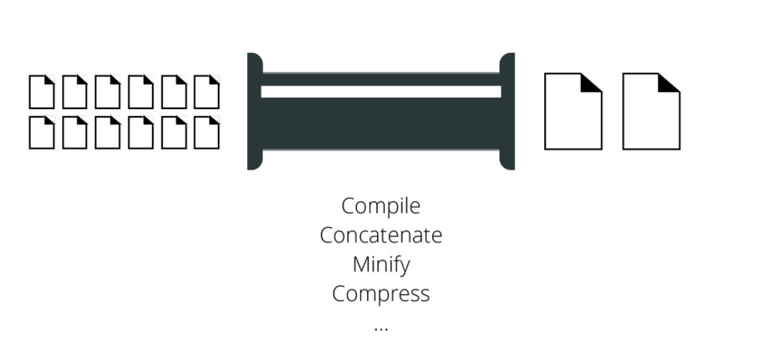
Asset Bundlers – What are they
Notes:
It’s generally more fun, easier, and overall a smoother experience to work with tools that have a vibrant community, a robust ecosystem, and a diversity of contributor experience and background.
React started as a small project but now has broad popularity and a vibrant community. No community is perfect, and React’s isn’t either, but as far as open source communities go, it has many important ingredients for success
Bunch of companies that use react
Facebook Netflix New Relic Uber Wealthfront Heroku PayPal
BBC Microsoft NFL And more! Asana ESPN Walmart
React is a fairly lightweight library in terms of responsibility and functionality. Where something like Angular may require you to “buy in” to a more comprehensive API, React is only concerned with the view of your application. This means it’s much more trivial to integrate it with your current technologies, and it will leave you room to make choices about other aspects.

Slide 4
Issues with traditional dependency management
How do you import functions from other peoples code? Consider:
Whats wrong with above? We import foo.js, bar.js etc. What if foo.js depends on bar.js? You must change the order of the scripts. Hmm this is becoming a mess. We really need to be careful with our `script src` ordering
You are using global variables ‘$’, which is we should avoid as much as possible.
This will become harder and harder to maintain with more complex dependencies.
// in jQuery
<script src="//code.jquery.com/jquery-1.12.0.min.js"></script>
<script src="/js/foo.js"></script>
<script src="/js/bar.js"></script>
<script src="/js/foobar.js"></script>
<script>
// `$` global variable available here
</script>
Notes:
It’s generally more fun, easier, and overall a smoother experience to work with tools that have a vibrant community, a robust ecosystem, and a diversity of contributor experience and background.
React started as a small project but now has broad popularity and a vibrant community. No community is perfect, and React’s isn’t either, but as far as open source communities go, it has many important ingredients for success
Bunch of companies that use react
Facebook Netflix New Relic Uber Wealthfront Heroku PayPal
BBC Microsoft NFL And more! Asana ESPN Walmart
React is a fairly lightweight library in terms of responsibility and functionality. Where something like Angular may require you to “buy in” to a more comprehensive API, React is only concerned with the view of your application. This means it’s much more trivial to integrate it with your current technologies, and it will leave you room to make choices about other aspects.

Slide 5
Webpack – What is it?
A static module/asset bundler for modern JavaScript applications
Give it a starting point, It then analyses and builds a dependency graph
Supports multiple types (css, fonts,images, html) using loaders. Not just JavaScript
Plugins are a powerful feature of webpack, most widely used for bundle optimization, minification, script injection etc.
Modules help you breakdown your codebase into smaller separate parts. These smaller modules can then be reused in other applications.
It starts with an entrypoint, this directs Webpack where to start building it’s internal dependency graph
Notes:
Go to babel js repl - https://babeljs.io/en/repl
Type
const h1 = <h1>This is a heading</h1>
My personal preference is toward the choose­your­own, does­one­thing­well approach, but that’s really neither here nor there; it’s all about tradeoffs. React doesn’t come with opinionated solutions for HTTP, routing, data modeling (although it certainly has opinions about data flow in your views, which we’ll get to), or other things you might see in something like Angular
One upside to the flexible approach of React is that you’re free to pick the best tools for the job. Don’t like the way X HTTP library works? No problem—swap it out for something else. Prefer to do forms in a different way? Implement it, no problem. React provides you with a set of powerful primitives to work with
t’s an unavoidable fact that JavaScript frameworks are rarely truly interoperable; you can’t usually have an app that’s part Angular, part Ember, part Backbone, and part React, at least not without segmenting off each part or tightly controlling how they interact

Slide 6
Webpack – Loaders
Bundlers (Webpack / Browserify) work with loaders and plugins that are responsible for converting assets into browser-compatible targets.
For example, accessing future, as-yet unsupported JavaScript language features like adding polyfills (polyfills help with dealing with cross-browser incompatibilities)
We have seen in React JS lecture where under the hood it used a BabelJS loader to transforms React JSX or ES7 JavaScript to vanilla JavaScript that is supported by all browsers.
Notes:
Go to babel js repl - https://babeljs.io/en/repl
Type
const h1 = <h1>This is a heading</h1>
My personal preference is toward the choose­your­own, does­one­thing­well approach, but that’s really neither here nor there; it’s all about tradeoffs. React doesn’t come with opinionated solutions for HTTP, routing, data modeling (although it certainly has opinions about data flow in your views, which we’ll get to), or other things you might see in something like Angular
One upside to the flexible approach of React is that you’re free to pick the best tools for the job. Don’t like the way X HTTP library works? No problem—swap it out for something else. Prefer to do forms in a different way? Implement it, no problem. React provides you with a set of powerful primitives to work with
t’s an unavoidable fact that JavaScript frameworks are rarely truly interoperable; you can’t usually have an app that’s part Angular, part Ember, part Backbone, and part React, at least not without segmenting off each part or tightly controlling how they interact

Slide 7
Webpack – Loaders cont..
There is a range of loaders and plugins, here is a short listing:
coffee-loader Loads CoffeeScript like JavaScript
elm-webpack-loader Loads Elm like JavaScript
html-loader Exports HTML as string, require references to static resources
sass-loader Loads and compiles a SASS/SCSS file
Notes:
Go to babel js repl - https://babeljs.io/en/repl
Type
const h1 = <h1>This is a heading</h1>
My personal preference is toward the choose­your­own, does­one­thing­well approach, but that’s really neither here nor there; it’s all about tradeoffs. React doesn’t come with opinionated solutions for HTTP, routing, data modeling (although it certainly has opinions about data flow in your views, which we’ll get to), or other things you might see in something like Angular
One upside to the flexible approach of React is that you’re free to pick the best tools for the job. Don’t like the way X HTTP library works? No problem—swap it out for something else. Prefer to do forms in a different way? Implement it, no problem. React provides you with a set of powerful primitives to work with
t’s an unavoidable fact that JavaScript frameworks are rarely truly interoperable; you can’t usually have an app that’s part Angular, part Ember, part Backbone, and part React, at least not without segmenting off each part or tightly controlling how they interact

Slide 8
Further reading and examples
http://webpack.github.io/
https://www.sitepoint.com/beginners-guide-webpack-module-bundling/
https://medium.com/hootsuite-engineering/webpack-101-an-introduction-to-webpack-3f59d21edeba
https://medium.com/ag-grid/webpack-tutorial-understanding-how-it-works-f73dfa164f01
My repo - https://github.com/paul-kelly-dit/webpack-playground

